Slide 1

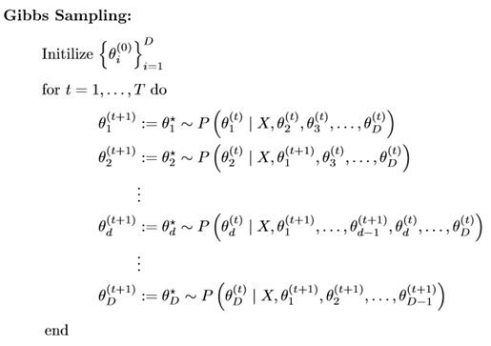
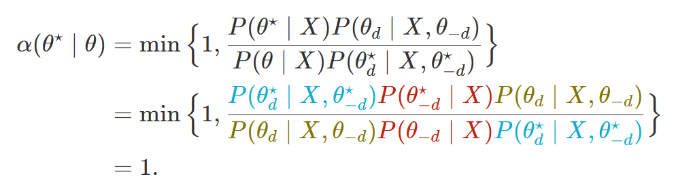
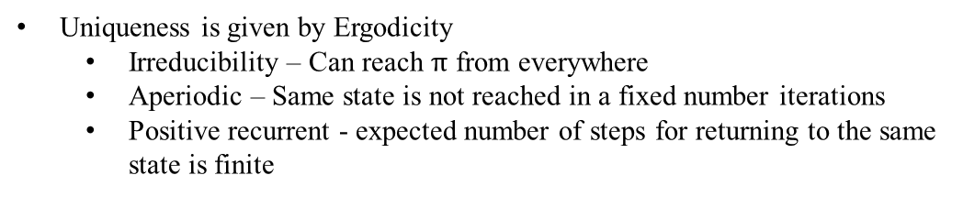
Markov Chain for MCMC
Uniqueness and existence of stationary distribution
Existence is given by Detailed Balance
Time and direction invariant. Only dependent on underlying density
.
Uniqueness is given by Ergodicity
Irreducibility – Can reach $π$ from everywhere
Aperiodic – Same state is not reached in a fixed number iterations
Positive recurrent - expected number of steps for returning to the same state is finite
Why does it work?

Slide 2
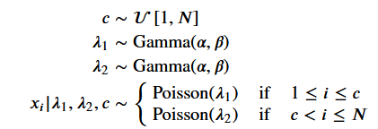
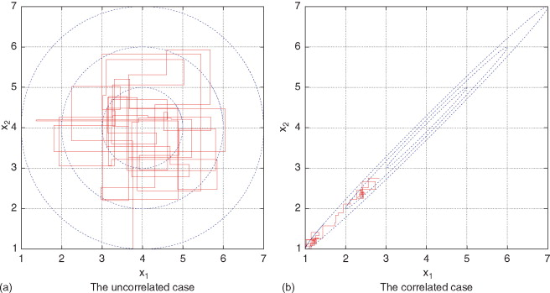
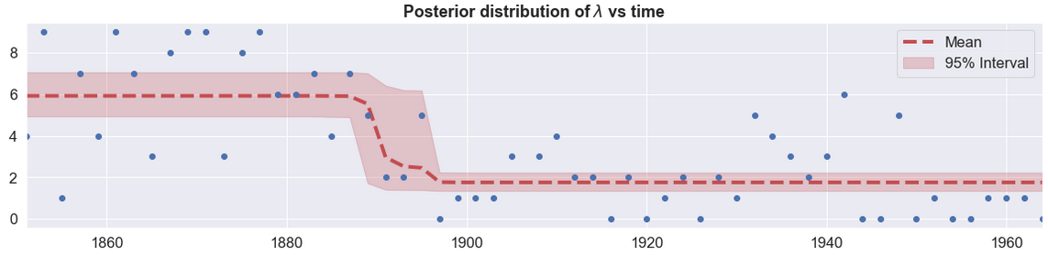
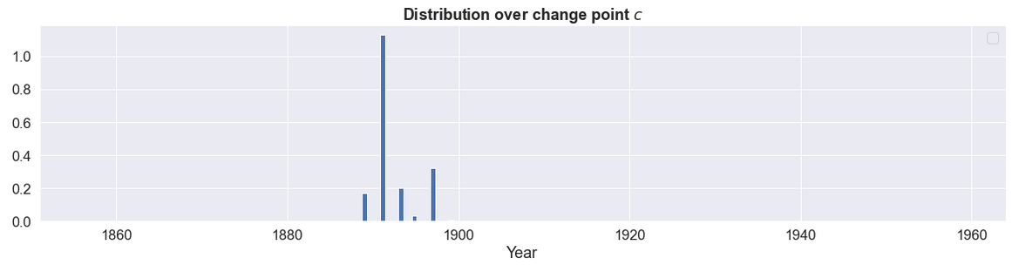
Gibbs Sampling
Primary Advantage
Proposals are always accepted
Primary Disadvantage
Access to the conditional posterior distribution

Slide 3
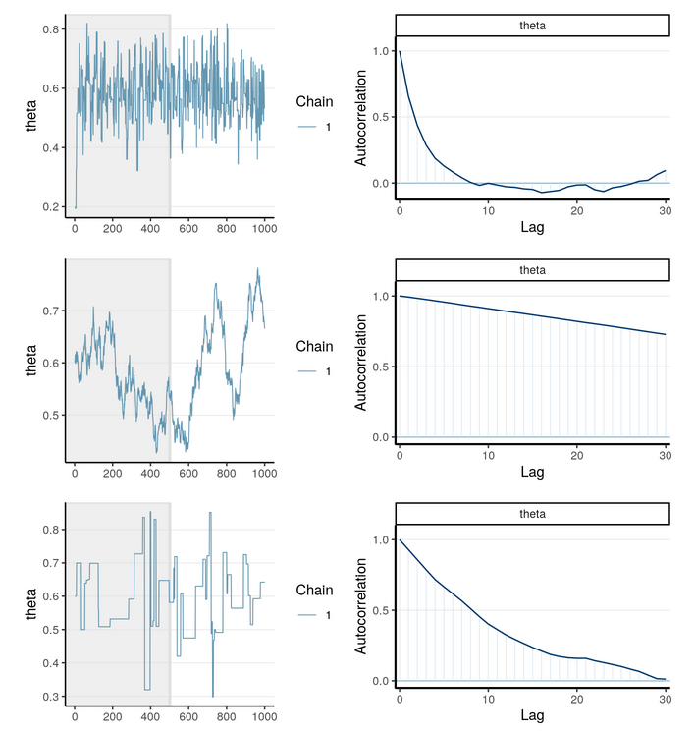
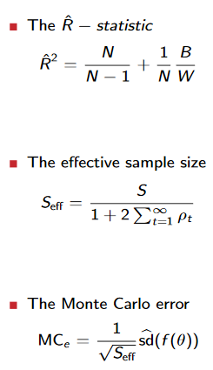
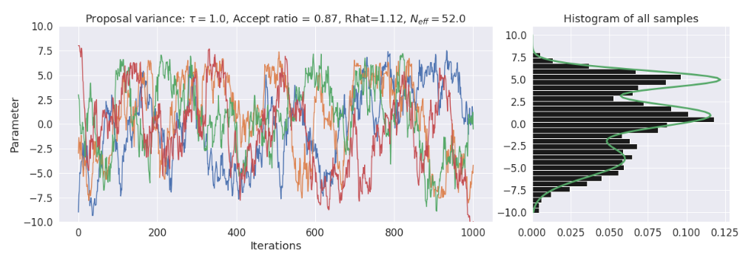
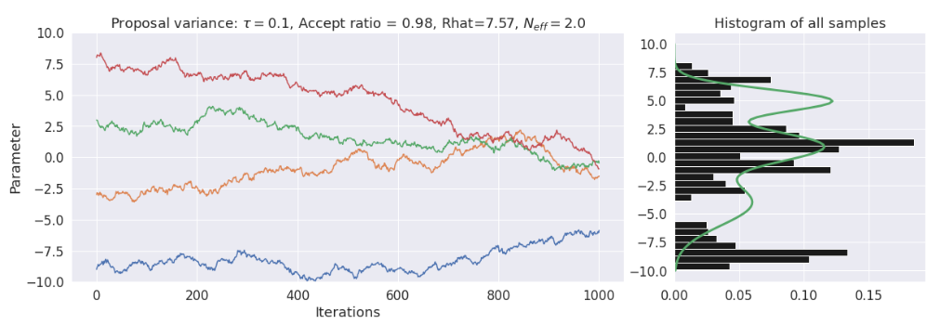
Convergence Diagnostics

